Slide 1

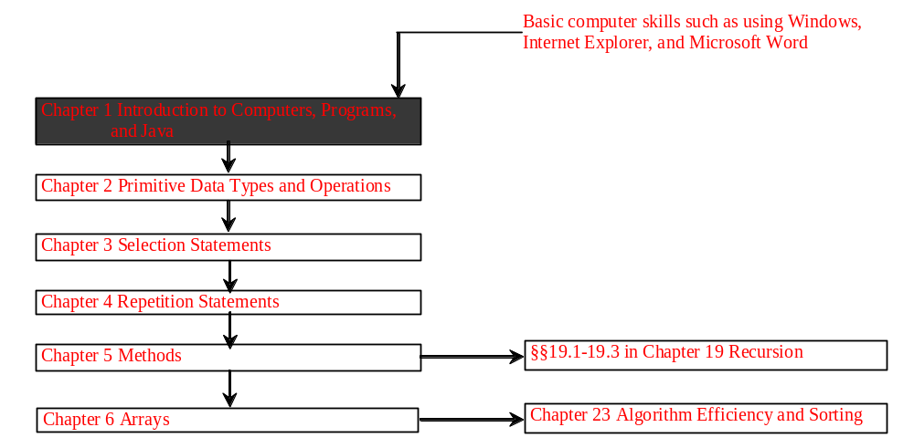
Chapter 1 Introduction to Computers, Programs, and Java

Slide 2
Why Java?
The answer is that Java enables users to develop and deploy applications on the Internet for servers, desktop computers, and small hand-held devices. The future of computing is being profoundly influenced by the Internet, and Java promises to remain a big part of that future. Java is the Internet programming language.
Java is a general purpose programming language.
Java is the Internet programming language.

Slide 3
Java, Web, and Beyond
Java can be used to develop Web applications.
Java Applets
Java Servlets and JavaServer Pages
Java can also be used to develop applications for hand-held devices such as Palm and cell phones

Slide 4
Examples of Java’s Versatility
Standalone Application: TicTacToe
Applet: TicTacToe
Servlets: SelfTest Web site
Mobile Computing: Cell phones

Slide 5
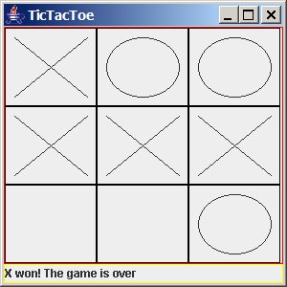
TicTacToe Standalone

Slide 6
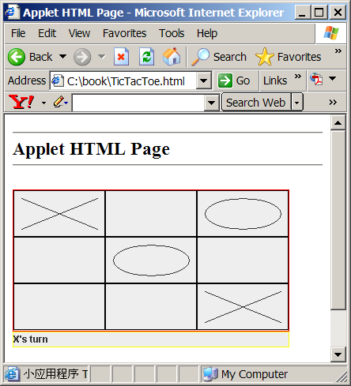
TicTacToe Applet

Slide 7
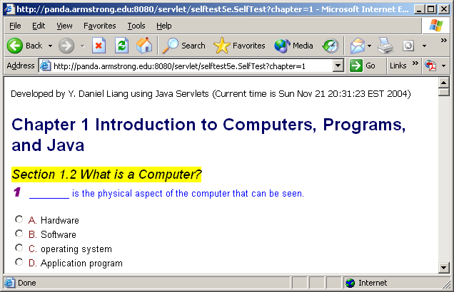
SelfTest Website (using Java Servlets)

Slide 8
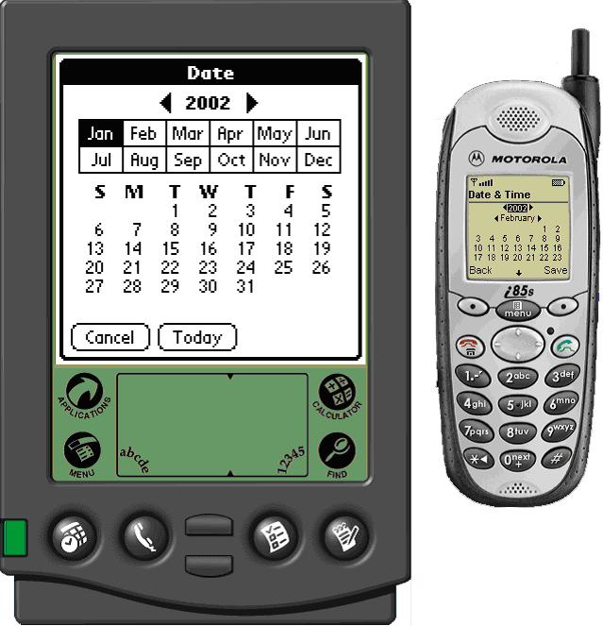
PDA and Cell Phone

Slide 9
Java’s History
James Gosling and Sun Microsystems
Oak
Java, May 20, 1995, Sun World
HotJava
  The first Java-enabled Web browser
Early History Website:
http://java.sun.com/features/1998/05/birthday.html

Slide 10
Characteristics of Java
Java Is Simple
Java Is Object-Oriented
Java Is Distributed
Java Is Interpreted
Java Is Robust
Java Is Secure
Java Is Architecture-Neutral
Java Is Portable
Java's Performance
Java Is Multithreaded
Java Is Dynamic
www.cs.armstrong.edu/liang/intro6e/JavaCharacteristics.pdf

Slide 11
Characteristics of Java
Java Is Simple
Java Is Object-Oriented
Java Is Distributed
Java Is Interpreted
Java Is Robust
Java Is Secure
Java Is Architecture-Neutral
Java Is Portable
Java's Performance
Java Is Multithreaded
Java Is Dynamic
Java is partially modeled on C++, but greatly simplified and improved. Some people refer to Java as "C++--" because it is like C++ but with more functionality and fewer negative aspects.

Slide 12
Characteristics of Java
Java Is Simple
Java Is Object-Oriented
Java Is Distributed
Java Is Interpreted
Java Is Robust
Java Is Secure
Java Is Architecture-Neutral
Java Is Portable
Java's Performance
Java Is Multithreaded
Java Is Dynamic
Java is inherently object-oriented. Although many object-oriented languages began strictly as procedural languages, Java was designed from the start to be object-oriented. Object-oriented programming (OOP) is a popular programming approach that is replacing traditional procedural programming techniques.
One of the central issues in software development is how to reuse code. Object-oriented programming provides great flexibility, modularity, clarity, and reusability through encapsulation, inheritance, and polymorphism.

Slide 13
Characteristics of Java
Java Is Simple
Java Is Object-Oriented
Java Is Distributed
Java Is Interpreted
Java Is Robust
Java Is Secure
Java Is Architecture-Neutral
Java Is Portable
Java's Performance
Java Is Multithreaded
Java Is Dynamic
Distributed computing involves several computers working together on a network. Java is designed to make distributed computing easy. Since networking capability is inherently integrated into Java, writing network programs is like sending and receiving data to and from a file.

Slide 14
Characteristics of Java
Java Is Simple
Java Is Object-Oriented
Java Is Distributed
Java Is Interpreted
Java Is Robust
Java Is Secure
Java Is Architecture-Neutral
Java Is Portable
Java's Performance
Java Is Multithreaded
Java Is Dynamic
You need an interpreter to run Java programs. The programs are compiled into the Java Virtual Machine code called bytecode. The bytecode is machine-independent and can run on any machine that has a Java interpreter, which is part of the Java Virtual Machine (JVM).

Slide 15
Characteristics of Java
Java Is Simple
Java Is Object-Oriented
Java Is Distributed
Java Is Interpreted
Java Is Robust
Java Is Secure
Java Is Architecture-Neutral
Java Is Portable
Java's Performance
Java Is Multithreaded
Java Is Dynamic
Java compilers can detect many problems that would first show up at execution time in other languages.
Java has eliminated certain types of error-prone programming constructs found in other languages.
Java has a runtime exception-handling feature to provide programming support for robustness.

Slide 16
Characteristics of Java
Java Is Simple
Java Is Object-Oriented
Java Is Distributed
Java Is Interpreted
Java Is Robust
Java Is Secure
Java Is Architecture-Neutral
Java Is Portable
Java's Performance
Java Is Multithreaded
Java Is Dynamic
Java implements several security mechanisms to protect your system against harm caused by stray programs.

Slide 17
Characteristics of Java
Java Is Simple
Java Is Object-Oriented
Java Is Distributed
Java Is Interpreted
Java Is Robust
Java Is Secure
Java Is Architecture-Neutral
Java Is Portable
Java's Performance
Java Is Multithreaded
Java Is Dynamic
Write once, run anywhere
With a Java Virtual Machine (JVM), you can write one program that will run on any platform.

Slide 18
Characteristics of Java
Java Is Simple
Java Is Object-Oriented
Java Is Distributed
Java Is Interpreted
Java Is Robust
Java Is Secure
Java Is Architecture-Neutral
Java Is Portable
Java's Performance
Java Is Multithreaded
Java Is Dynamic
Because Java is architecture neutral, Java programs are portable. They can be run on any platform without being recompiled.

Slide 19
Characteristics of Java
Java Is Simple
Java Is Object-Oriented
Java Is Distributed
Java Is Interpreted
Java Is Robust
Java Is Secure
Java Is Architecture-Neutral
Java Is Portable
Java's Performance
Java Is Multithreaded
Java Is Dynamic
Java’s performance Because Java is architecture neutral, Java programs are portable. They can be run on any platform without being recompiled.

Slide 20
Characteristics of Java
Java Is Simple
Java Is Object-Oriented
Java Is Distributed
Java Is Interpreted
Java Is Robust
Java Is Secure
Java Is Architecture-Neutral
Java Is Portable
Java's Performance
Java Is Multithreaded
Java Is Dynamic
Multithread programming is smoothly integrated in Java, whereas in other languages you have to call procedures specific to the operating system to enable multithreading.

Slide 21
Characteristics of Java
Java Is Simple
Java Is Object-Oriented
Java Is Distributed
Java Is Interpreted
Java Is Robust
Java Is Secure
Java Is Architecture-Neutral
Java Is Portable
Java's Performance
Java Is Multithreaded
Java Is Dynamic
Java was designed to adapt to an evolving environment. New code can be loaded on the fly without recompilation. There is no need for developers to create, and for users to install, major new software versions. New features can be incorporated transparently as needed.

Slide 22
JDK Versions
JDK 1.02 (1995)
JDK 1.1 (1996)
JDK 1.2 (1998)
JDK 1.3 (2000)
JDK 1.4 (2002)
JDK 1.5 (2004) a. k. a. JDK 5 or Java 5

Slide 23
JDK Editions
Java Standard Edition (J2SE)
  J2SE can be used to develop client-side standalone applications or applets.
Java Enterprise Edition (J2EE)
  J2EE can be used to develop server-side applications such as Java servlets and Java ServerPages.
Java Micro Edition (J2ME).
  J2ME can be used to develop applications for mobile devices such as cell phones.
This book uses J2SE to introduce Java programming.

Slide 24
A Simple Java Program
Listing 1.1
//This program prints Welcome to Java!
public class Welcome {
public static void main(String[] args) {
System.out.println("Welcome to Java!");
}
}
Source
IMPORTANT NOTE: To run the program from the Run button, (1) set c:\Program Files\java\jdk1.5.0\bin for path, and (2) install slides from the Instructor Resource Website to a directory (e.g., c:\LiangIR) .
Run

Slide 25
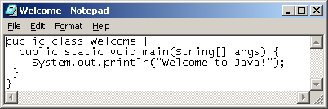
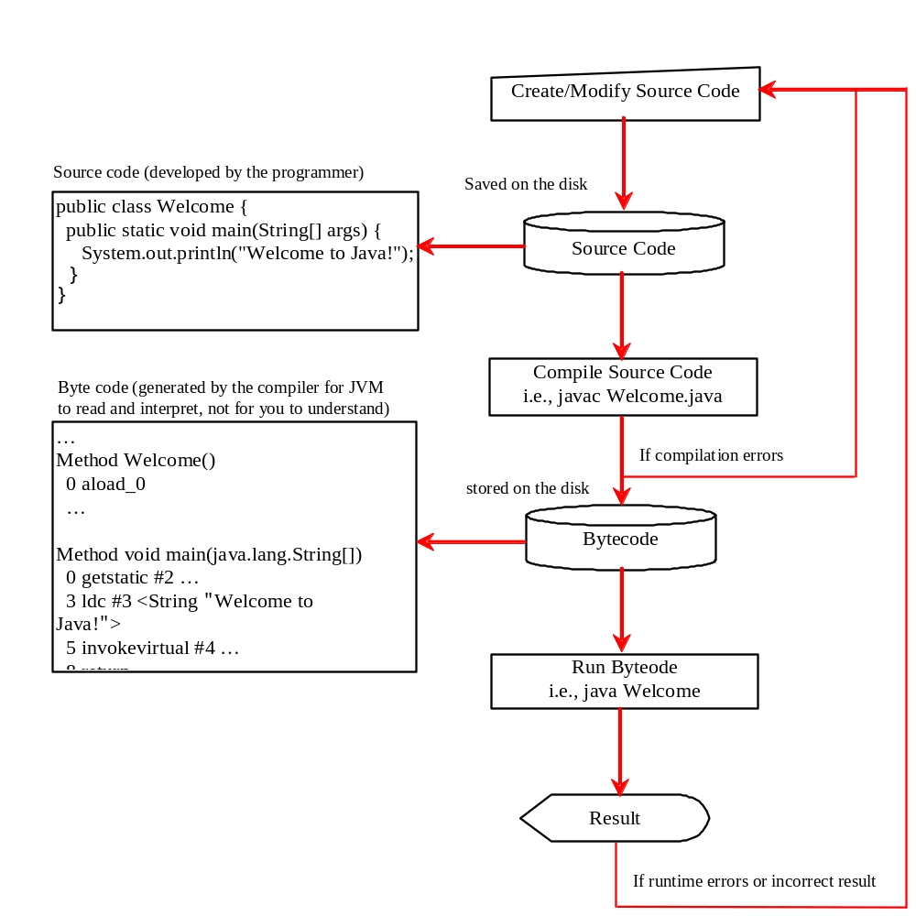
Creating, Compiling, and Running Programs

Slide 26
Supplements on the Companion Website
See Supplement A for installing and configuring JDK 1.5
See Supplement B for compiling and running Java from the command window for details

Slide 27

Compiling and Running Java from the Command Window
Set path to JDK bin directory
  set path=c:\Program Files\java\jdk1.5.0\bin
Set classpath to include the current directory
  set classpath=.
Compile
  javac Welcome.java
Run
  java Welcome

Slide 28
Anatomy of a Java Program
Comments
Package
Reserved words
Modifiers
Statements
Blocks
Classes
Methods
The main method

Slide 29
Comments
In Java, comments are preceded by two slashes (//) in a line, or enclosed between /* and */ in one or multiple lines. When the compiler sees //, it ignores all text after // in the same line. When it sees /*, it scans for the next */ and ignores any text between /* and */.

Slide 30
Package
The second line in the program (package chapter1;) specifies a package name, chapter1, for the class Welcome. Forte compiles the source code in Welcome.java, generates Welcome.class, and stores Welcome.class in the chapter1 folder.

Slide 31
Reserved Words
Reserved words or keywords are words that have a specific meaning to the compiler and cannot be used for other purposes in the program. For example, when the compiler sees the word class, it understands that the word after class is the name for the class. Other reserved words in Listing 1.1 are public, static, and void. Their use will be introduced later in the book.

Slide 32
Modifiers
Java uses certain reserved words called modifiers that specify the properties of the data, methods, and classes and how they can be used. Examples of modifiers are public and static. Other modifiers are private, final, abstract, and protected. A public datum, method, or class can be accessed by other programs. A private datum or method cannot be accessed by other programs. Modifiers are discussed in Chapter 6, “Objects and Classes.”

Slide 33
Classes
The class is the essential Java construct. A class is a template or blueprint for objects. To program in Java, you must understand classes and be able to write and use them. The mystery of the class will continue to be unveiled throughout this book. For now, though, understand that a program is defined by using one or more classes.

Slide 34
Methods
What is System.out.println? It is a method: a collection of statements that performs a sequence of operations to display a message on the console. It can be used even without fully understanding the details of how it works. It is used by invoking a statement with a string argument. The string argument is enclosed within parentheses. In this case, the argument is "Welcome to Java!" You can call the same println method with a different argument to print a different message.

Slide 35
main Method
The main method provides the control of program flow. The Java interpreter executes the application by invoking the main method.
The main method looks like this:
public static void main(String[] args) {
// Statements;
}

Slide 36
Displaying Text in a Message Dialog Box
you can use the showMessageDialog method in the JOptionPane class. JOptionPane is one of the many predefined classes in the Java system, which can be reused rather than “reinventing the wheel.”
Source
IMPORTANT NOTE: To run the program from the Run button, (1) set c:\jdk1.5.0\bin for path, and (2) install slides from the Instructor Resource Website to a directory (e.g., c:\LiangIR) .
Run

Slide 37
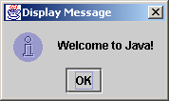
The showMessageDialog Method
JOptionPane.showMessageDialog(null,
"Welcome to Java!",
“Display Message",
JOptionPane.INFORMATION_MESSAGE));

Slide 38
Two Ways to Invoke the Method
There are several ways to use the showMessageDialog method. For the time being, all you need to know are two ways to invoke it.
One is to use a statement as shown in the example:
  JOptionPane.showMessageDialog(null, x,
  y, JOptionPane.INFORMATION_MESSAGE));
where x is a string for the text to be displayed, and y is a string for the title of the message dialog box.
The other is to use a statement like this:
  JOptionPane.showMessageDialog(null, x);
where x is a string for the text to be displayed.

Slide 39
The exit Method
Prior to JDK 1.5, you have to invoke System.exit() to terminate the program if the program uses JOptionPane dialog boxes. Since JDK 1.5, it is not necessary.

